Slide 1
RISK MANAGEMENT FRAMEWORK (RMF) for DoD IT Sales

Slide 2
This Course
RMF for DoD IT Fundamentals is a one-day standalone class
Also, first day of a four-day program:
RMF for DoD IT In Depth (three days) will follow
Class “estimated” time schedule
  Morning: 3.5 hours (e.g., 8:30am – 12:00pm)
  Lunch: 1 hour (e.g., 12:00pm – 1:00pm)
  Afternoon: 4 hours (e.g., 1:00pm – 5:00pm)
  Short breaks during morning & afternoon sessions
Additional one-day add-ons; e.g., eMASS Essentials; STIG 101 (online)
Class format: Lecture, discussion, team activities
Class is offered both onsite and online
Notes:
>> The estimated time schedule is just that – an estimate. A lot will depend on the number and nature of questions that are asked. Also, in general, smaller size classes tend to go faster than larger ones. It’s therefore possible we might finish early. If the opposite turns out to be true, your instructor will make every effort to not let the class run too late … without sacrificing quality or omitting important material.
>> Also, for online students, please note we have students in multiple time zones, so the “lunch” break may not come at the most opportune time for you. We ask you to bear with us and be as flexible as possible.
Check with students to make sure they know if they are registered for one day only (D1); 4 days (D4); plus add-on day (D5)

Slide 3
Background / Problem
Risk Management Framework (RMF) is a life cycle process for managing information security risk
RMF is now the standard risk management process for information systems in:
  Federal “civil” departments/agencies
  Intelligence community
  DoD
DoD employees and contractors need to be educated in RMF as soon as possible
Notes:
RMF is not just a DoD process; it is the “standard” process for federal civil agencies and the intelligence community as well. Of course, DoD has made a few adaptations and added a few “wrinkles” to make the process “their own” … at least a little bit. Everyone involved with DoD IT – government employees, contractors, even product vendors and “outsourced” service providers – needs to get up to speed on this new process soonest.

Slide 4
Solution
This class will provide you with working level knowledge of:
  The Risk Management Framework (RMF) process
  Implementation of RMF in the DoD environment (“RMF for DoD IT”)
  RMF Resources – websites, publications, automated tools
Notes:
That’s why we’re here. Our goal is to get you familiar with RMF and how it is being implemented in the DoD environment., as well as the many RMF Resources such as websites, publications and automated tools.

Slide 5
Student will learn:
  Information security & risk management foundations
  RMF policy background
  Supporting laws and publications (i.e., FISMA, DoD, NIST and CNSS*)
  RMF roles & responsibilities
  Life cycle steps – preparation, categorization, selection, implementation, assessment and monitoring of security controls, and authorization of information systems
  Documentation of security controls
  Supporting resources – websites, automated tools
*Federal Information Security Management Act (FISMA); Department of Defense (DoD); National Institute of Standards and Technology (NIST); Committee on National Security Systems (CNSS)
Notes:
It is obvious we cannot provide “program, system or environment-specific guidance” (since we don’t know the specifics of where you work or what you do). However, please feel free to bring up issues related to your specific work environment, whether you’re seeking guidance or just feel your contribution will add value to the class. And, of course, please keep information sensitivity in mind when doing so.

Slide 6
Target Audience
This course has been developed for an audience who
  Work or manage in the area of DoD information security
  Work or manage in a DoD IT environment (hardware, software, network, etc.)
  Design, develop or maintain systems that require approval to operate in a DoD environment
Notes:
6
A plethora of information will be presented during this class. Since the curriculum has been developed for a diverse audience, some of the material will be directly relevant (bullseye!) to your particular role within your organization and within the RMF process. Other material may seem rather tangential to your expected role. You are encouraged, however, to pay close attention to all of it. Our experience is that individuals’ roles tend to evolve over time … what seems peripheral today may become crucial tomorrow … especially when you return to your work environment as “the knowledgeable one” after attending this training!

Slide 7
Job Roles that would benefit from training:
Information Systems Security Manager/Officer (ISSM/ISSO)
  Will learn how to plan the RMF project (timeframes, milestones, assignments, etc.)
  Will learn the importance of building an RMF project team
  Will learn the importance of risk assessment and how it ties to every step of the RMF process
  Will learn how to build an implementation plan and artifacts that will lead to a successful independent assessment
  Will learn how to perform internal assessment and generate control correlation identifier (CCI) test results
  Will learn the importance of continuous monitoring of controls throughout the entire life-cycle of the system
Notes:
7

Slide 8
Job Roles that would benefit from training:
Information System Owner/Program Manager (ISO/PM)
  Will learn the importance of planning the RMF project
  Will learn the importance of risk assessment, risk management and risk decision-making
  Will learn how to support the RMF project team as needed with additional time, money or people
  Will learn the key responsibilities of the ISO/PM
    Budgeting funds for the system;
    Ownership of the system Plan of Action & Milestones (POA&M);
    Responsibility for system categorization;
    Responsible for establishing an Information System Continuous Monitoring Program
Notes:
8

Slide 9
Job Roles that would benefit from training:
System Administrators, Network Administrators, Helpdesk Personnel
  Will learn how to support the RMF project team with implementation guidance as Subject Matter Experts (SMEs); documentation; system scans; automated tools
  Will learn how to build an implementation plan and artifacts that will lead to a successful independent assessment
  Will learn the importance of risk assessment and how it ties to every step of the RMF process
  Will learn consequences if system does not have a successful independent assessment
Notes:
9

Slide 10
Job Roles that would benefit from training:
Application Developers, Data Base Managers
  Will learn how to support the RMF project team with implementation guidance as Subject Matter Experts (SMEs); documentation; application reviews and audits
  Will learn how to build an implementation plan and artifacts that will lead to a successful independent assessment
  Will learn the importance of risk assessment and how it ties to every step of the RMF process
  Will learn consequences if system does not have a successful independent assessment
Notes:
10

Slide 11
Job Roles that would benefit from training:
Engineers, Architects, User Representatives, Mission Contractors
  Will learn how the RMF process supports the DoD missions
  Will learn to work as part of an RMF project team to build a successful RMF package
  Will learn to work with system personnel (i.e., ISSM/ISSO, System/Network Administrators, Developers) to provide system security to support the mission
  Will learn the importance of risk assessment, risk management and risk decision-making
  Will learn consequences if system does not have a successful independent assessment
Notes:
11

Slide 12

RMF “Publications Library”
Copies of the RMF publications we discuss in this class are available on the BAI RMF Resource Center website.
https://rmf.org/rmf-documents
Consider downloading these publications to your Kindle or computer tablet for some “light reading on the go”.
Notes:
You can go to the RMF.org Resources menu to download updates of publications presented in this class. You will find them under RMF Resources/RMF Publications.

Slide 13
RMF LIFE CYCLE
Students will work on team activities that represent each step of the life cycle.

Slide 14
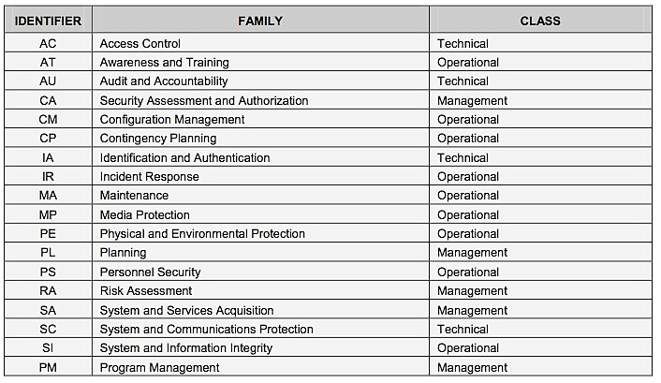
Select Security Controls
Students will learn about the families of Security Controls and how to development an implementation plan for their system controls.

Slide 15
Document and Assess Controls;
Develop System-level Continuous Monitoring
Students will learn how to build artifacts for their security controls providing evidence of implementation.
Students will learn how to Assess Security Controls and prepare for an Independent Assessment from an external assessor.
Students will learn how to develop a Continuous Monitoring Strategy for their high-priority controls, providing real-time risk assessment and decision making.
Finally, students will learn about RMF changes that are coming soon and how they may impact our systems

Slide 16
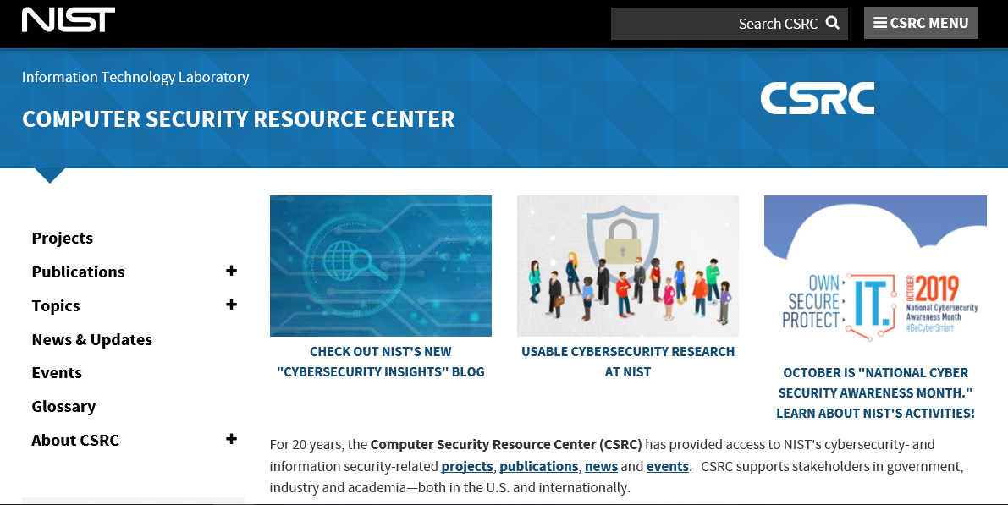
Students will learn about resources - websites
Source: https://csrc.nist.gov
Notes:
The NIST Computer Security Resource Center (CSRC) is a comprehensive repository of information security publications information about upcoming conferences and events, and technical guidance.

Slide 17
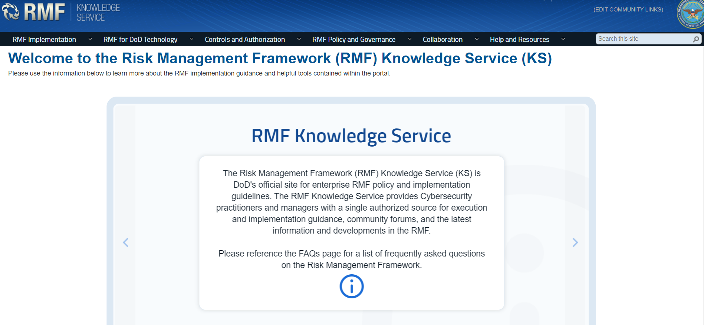
Students will learn about the Knowledge Service – official repository of DoD RMF information
https://rmfks.osd.mil (CAC or ECA required)
Notes:
The RMF Knowledge Service (KS) is the official DoD repository of RMF information. It is maintained and managed by the RMF Technical Advisory Group (TAG) under the supervision of the DoD SISO.
Anyone involved with RMF on a regular basis is encouraged to use KS as a resource. There is even a Forum where you can post questions and receive answers from your peers.

Slide 18
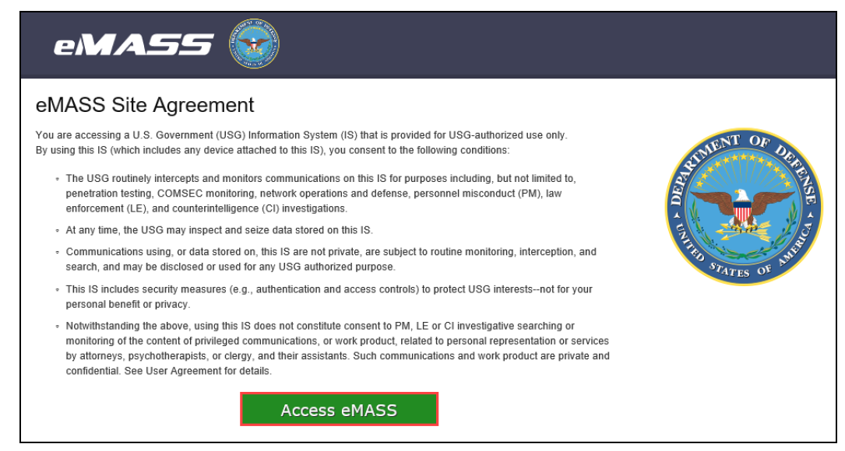
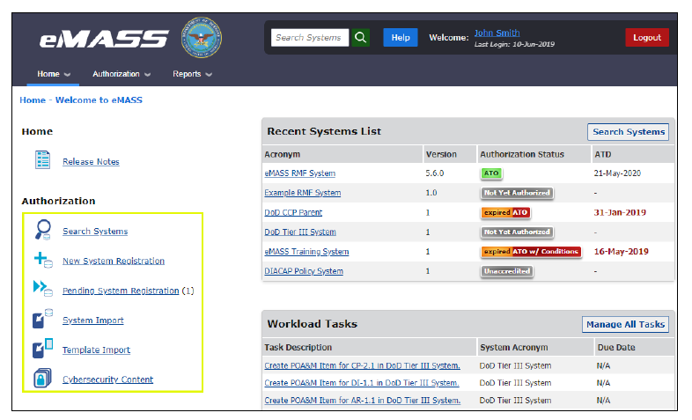
Students will learn about tools that assist in RMF package preparation
Notes:
These screen shots illustrate the use of eMASS. You can also see on the eMASS “home page” there are place holders for Workload Tasks and Notifications, which support the “workflow” functionality.

Slide 19


Students will learn about us (BAI) and how we can help them
RMF Resource Center
1-800-RMF-1903
www.rmf.org
E-mail: rmf@rmf.org
Please email us. We’d love to hear from you!
Notes:
19
19
19
Please email us and let us know what you liked about the course, what you would like to see added, and anything you want to share. We would love to hear from you.

